Slide 1
Unit VI Creating an interactive dashboard

Slide 2
Index
Principles of Dashboarding
Mastering charting techniques
Macros for interactive dashboard
Visualizations with Sparklines and Shapes
Specialized charts – Waterfall chart, funnel chart, adding maps on dashboard, adding slicers and timelines
Connecting slicers with multiple pivot tables
Adding hyperlinks to navigate between different sheets

Slide 3
1. Key Principles
The 5 Second Rule: Your dashboard should provide the relevant information in about 5 seconds.
2. Logical Layout: the Inverted Pyramid: Display the most significant insights on the top part of the dashboard, trends in the middle, and granular details in the bottom.
3. Minimalism: Less Is More: Each dashboard should contain no more than 5-9 visualizations.
4. Choosing the Right Data Visualization: Select the appropriate type of data visualization according to its purpose.
https://www.sisense.com/blog/4-design-principles-creating-better-dashboards/

Slide 4
2. Mastering charting techniques
The bar chart is one of the most fundamental data visualizations. Levels are plotted on one axis, while values are on the other. The length of the bar indicates its value.
Best for: Showing the distribution of data points and comparing subgroup values.
A line chart plots points and connects them with a line moving from left to right. By observing whether the line rises or falls, readers can discern the changes in the data.
Best for: Predicting outcomes and revealing trends
A scatter plot identifies two or more variables and reveals their relationship. The position of various data points can provide visual trends and patterns.
Best for: Identifying outliers and gaps in data
Notes:
https://www.atlassian.com/data/charts#:~:text=Data%20charting%20best%20practices,color%20consistency%20throughout%20your%20charts

Slide 5
A histogram is a type of bar chart. One variable is quantitative, which can help visualize the data distribution.
Best for: Showing the distribution of a data set
An area chart is a specialized form of a line graph. It has a shaded region between the line and the baseline.
Best for: Showing changes over time
A bubble chart is a modification of a scatter plot. It can add variables using color, shape, or size for each point as indicators.
Best for: Discovering a relationship between three variables

Slide 6
A heatmap is another data visualization that reveals relationships between groups. In this case, color demonstrates values—typically when one or more variables are not numerical.
Best for: Comparing data density and user interaction analysis
Pie charts depict values as areas sliced from a circle. Categorical data is a good option for pie charts. Keep the number of categories small and ensure the data is additive for the best results.
Best for: Part-to-whole comparisons and showing relative sizes

Slide 7
Charts
1. Showing change over time
Bar chart
Line chart
Box plot
2. Showing part-to-whole composition
Pie chart
Stacked bar chart
Stacked area chart
3. Showing data distribution
Bar chart
Histogram
Density curve
Violin plot
Box plot
4. Comparing values between groups
Bar chart
Dot plot
Line chart
Grouped bar chart
Violin plot
Box plot
Funnel chart

Slide 8
5. Observing relationships between variables
Scatter plot
Bubble chart
Dual-axis plot
Heatmap
6. Evaluating geographical data
Choropleth
Cartograms

Slide 9
3. Macros for interactive dashboard
A dashboard is a visual representation of KPIs, key business metrics, and other complex data in a way that’s easy to understand.
Gives you a detailed overview of your business’ Key Performance Indicators at a glance
Adds a sense of accountability as different people and departments can see the areas of improvement
Provides powerful analytical capabilities and complex calculations
Helps you make better decisions for your business

Slide 10
interactive Excel dashboard
An interactive Excel dashboard is a data management tool that harnesses the power of Excel data analysis tools such as Pivot Tables and Pivot Charts to track, analyze, monitor, and display key business metrics.
In an interactive Excel dashboard, data becomes visually meaningful, and with tools such as slicers, users can interact with the data enabling them to derive important insights and make data-driven well-informed business decisions.

Slide 11
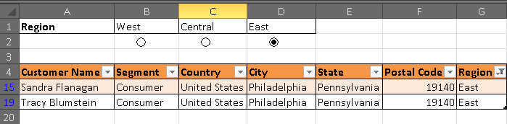
Macros for interactive dashboard
Sub West()
ActiveSheet.ListObjects("Table2").Range.AutoFilter Field:=7, Criteria1:="West"
End Sub
Sub Central()
ActiveSheet.ListObjects("Table2").Range.AutoFilter Field:=7, Criteria1:="Central"
End Sub

Slide 12
An interactive Excel dashboard
Start with a Clean Dataset
Format data as a Table
Create the first Pivot table and Pivot Charts
Create Multiple Pivot table and Pivot Charts for other variables
Assemble the Excel dashboard
Add Slicers & Timelines
Connect Slicers to data
Update the Excel Dashboard
https://www.simonsezit.com/article/how-to-create-an-excel-dashboard-in-five-minutes/

Slide 13
Step i: Start with a Clean Dataset
You must start with a clean dataset before analyzing it with a Pivot Table or Pivot Chart.
If your dataset is imported, you may get errors and inconsistencies that need fixing before you start

Slide 14
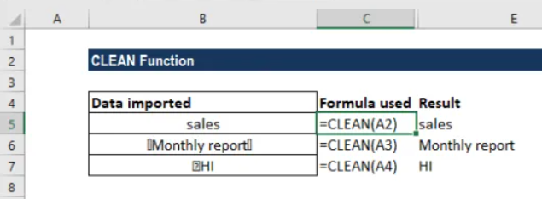
https://corporatefinanceinstitute.com/resources/excel/clean-function/#:~:text=Using%20the%20SHIFT%20key%2C%20select,data%20point%20on%20our%20list.

Slide 15
Check the type of data in a cell
Convert numbers stored as text into numbers
Eliminate blank cells in a list or range
Clean data using split the text into columns
Concatenate text using the TEXTJOIN function
Change text to lower – upper – proper case
Remove non-printable characters using the CLEAN formula

Slide 16
Here are some steps to clean data in Excel:
Select the entire data
Press F5
Select Special
Select Blanks
Click OK
All blank cells will be highlighted in pale grey color, out of which one cell would be white with a different border
Hit Ctrl+Enter

Slide 17
Step ii: Format as a Table
If you plan on updating or adding more information to your dataset, you need to put your data in an Excel table before analyzing it.
Tables can auto-expand and accommodate any new data.

Slide 18
Step iii-iv: Create the first Pivot Table and Pivot Chart
It is time to create the first Pivot Table and Pivot Chart for the dashboard.
Arrange the Pivot Table fields as required.
Name the worksheet tab so it is easy to identify.
Click in the Pivot Table and create a Pivot Chart on the same worksheet

Slide 19
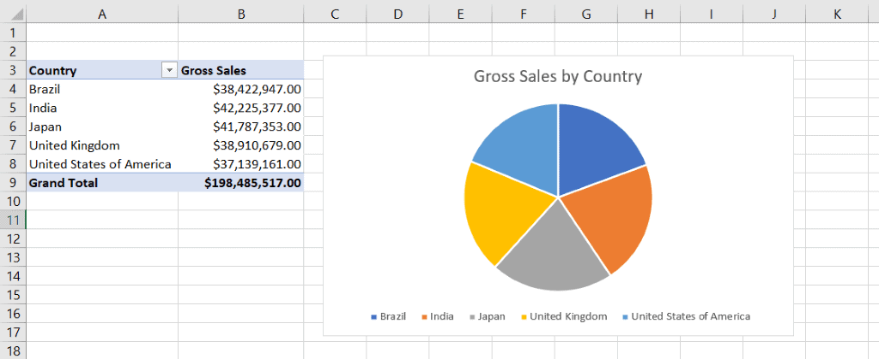

Slide 20

Create Multiple Pivot Charts
Assembling the Excel Dashboard
After you have created all the Pivot Tables and Pivot Charts, you can now assemble the Excel dashboard.
Create a new worksheet and name its ‘Dashboard’.
Copy the Pivot Charts from the other worksheets, and Paste them on to the dashboard.

Slide 21
Step v- vi: Adding Slicers and Timelines
You can add filters in the form of Slicers and Timelines to a dashboard in Excel.
These help users interact with the Excel dashboard and view it in different ways.
You can add one or more slicers to a dashboard to filter the data.

Slide 22
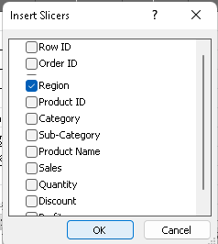
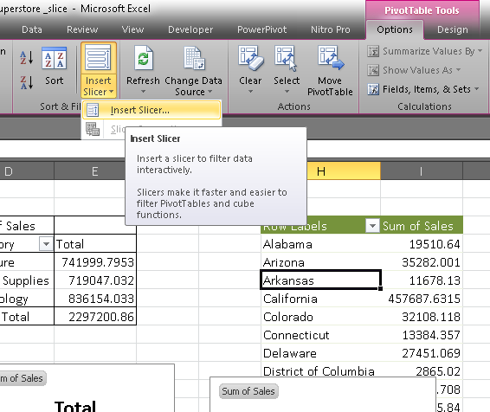
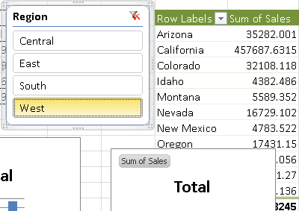

Slide 23
In earlier versions of Microsoft Excel, you can use report filters to filter data in a PivotTable report (PivotTable report:
An interactive, cross tabulated Excel report that summarizes and analyzes data, such as database records, from various sources, including ones that are external to Excel.), but it is not easy to see the current filtering state when you filter on multiple items.
In Microsoft Excel 2010, you have the option to use slicers to filter the data.
Slicers provide buttons that you can click to filter PivotTable data.
In addition to quick filtering, slicers also indicate the current filtering state, which makes it easy to understand what exactly is shown in a filtered PivotTable report.

Slide 24
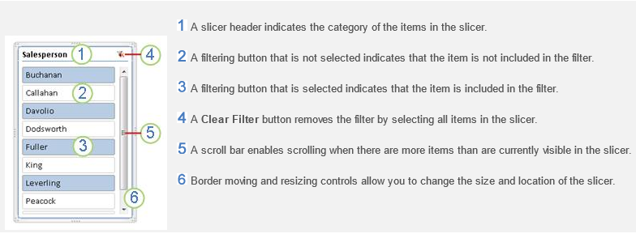
Slicers are easy-to-use filtering components that contain a set of buttons that enable you to quickly filter the data in a PivotTable report, without the need to open drop-down lists to find the items that you want to filter.

Slide 25
Because each slicer that you create is designed to filter on a specific PivotTable field, it is likely that you will create more than one slicer to filter a PivotTable report.

Slide 26
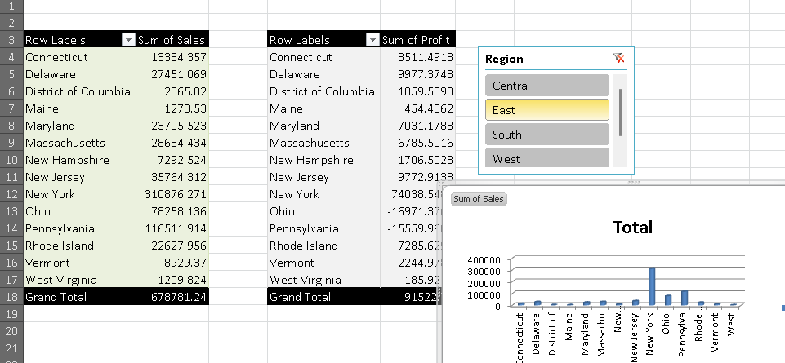

Slide 27
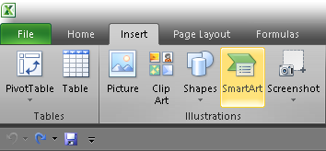
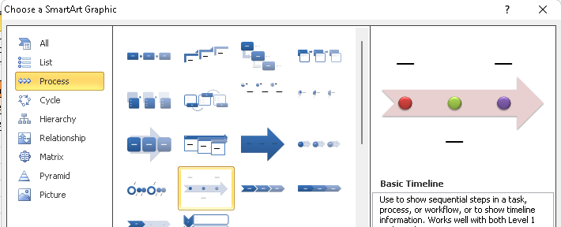
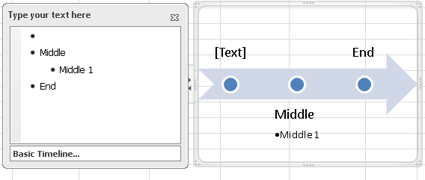
Timeline

Slide 28
4.1 Sparklines
4.1 A sparkline is a tiny chart in a worksheet cell that provides a visual representation of data.
Use sparklines to show trends in a series of values.
Add a Sparkline
Select a blank cell at the end of a row of data.
Select Insert and pick Sparkline type, like Line, or Column.
Select cells in the row and OK in menu.

Slide 29
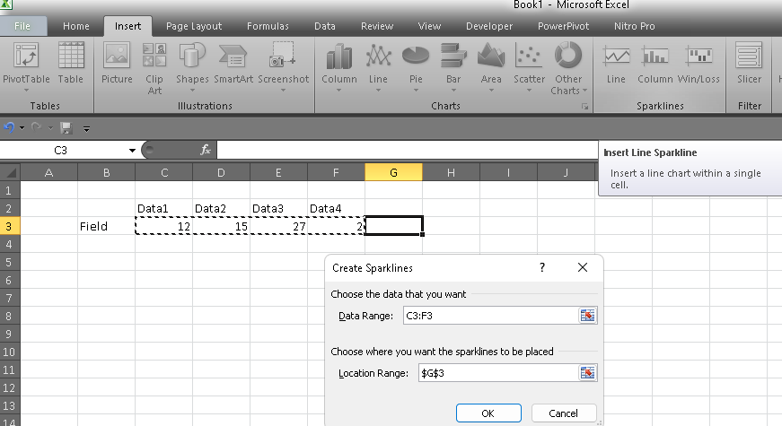


Slide 30
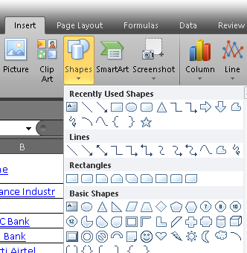
4.2 Shapes in excel

Slide 31
5. Specialized charts
5.1 Waterfall chart
5.2 Funnel chart
5.3 Adding maps on dashboard
5.4 Adding slicers and timelines

Slide 32
5 Waterfall chart
A waterfall chart shows a running total as values are added or subtracted. It's useful for understanding how an initial value (for example, net income) is affected by a series of positive and negative values.
The columns are color coded so you can quickly tell positive from negative numbers. The initial and the final value columns often start on the horizontal axis, while the intermediate values are floating columns. Because of this "look", waterfall charts are also called bridge charts.

Slide 33
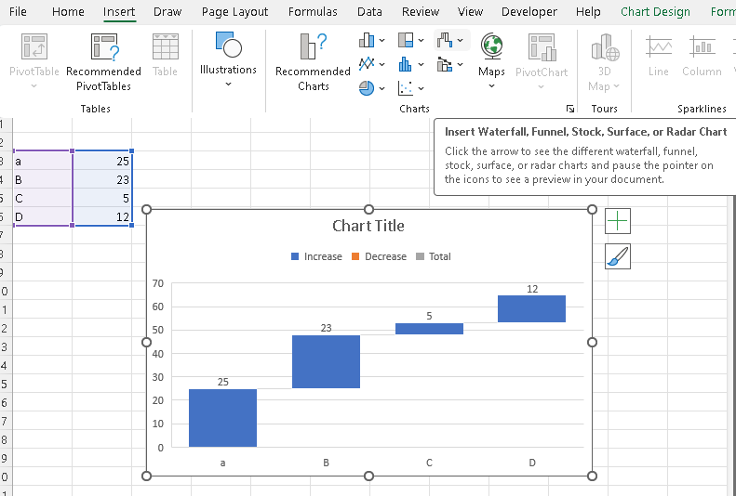

Slide 34
5.1 Waterfall chart (2010 VERSION)
A waterfall chart shows a running total as values are added or subtracted.
It's useful for understanding how an initial value is affected by a series of positive and negative values.
Steps:
Rearrange the data table
Insert formulas
Create a standard Stacked Column chart
Transform the column graph into a waterfall chart
Format Excel bridge chart
https://support.microsoft.com/en-us/office/create-a-waterfall-chart-8de1ece4-ff21-4d37-acd7-546f5527f185

Slide 35
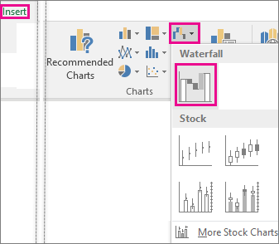
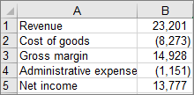
5.1.1 Rearrange the data table
Select your data.
Click Insert > Insert Waterfall or Stock chart > Waterfall.

Slide 36
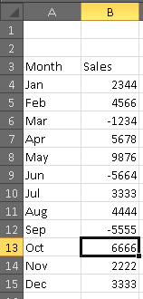
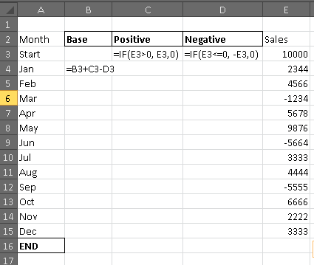
5.1.1 Rearrange the data table [o]
https://www.ablebits.com/office-addins-blog/waterfall-chart-in-excel/

Slide 37
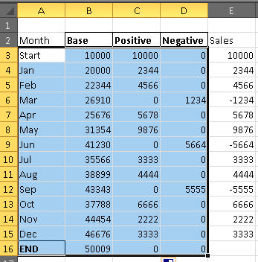
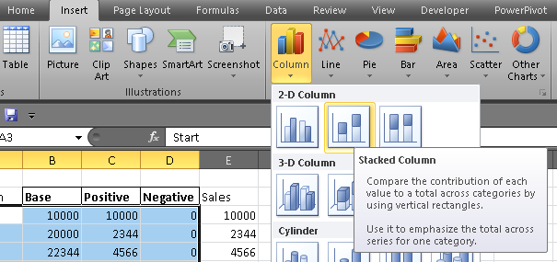

Slide 38
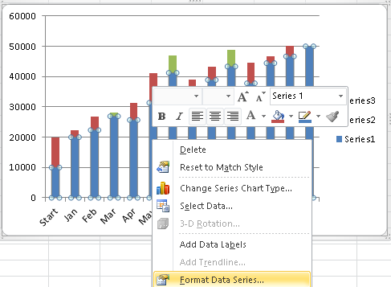
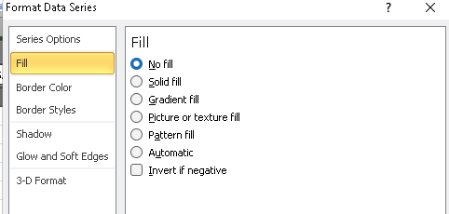
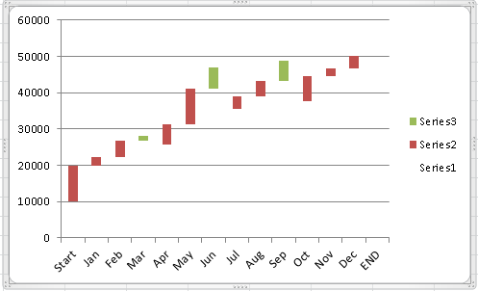

Slide 40
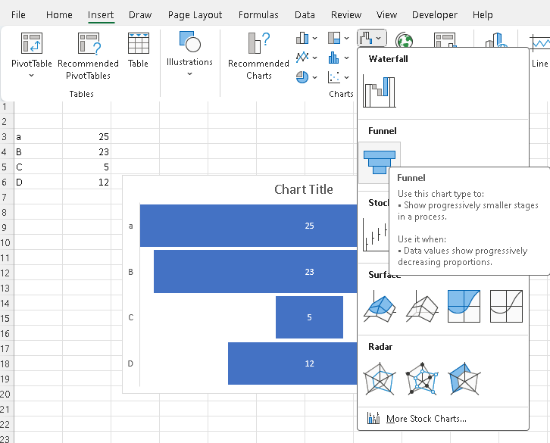
5.2 Funnel chart

Slide 41
Funnel charts show values across multiple stages in a process.
For example, you could use a funnel chart to show the number of sales prospects at each stage in a sales pipeline.
Typically, the values decrease gradually, allowing the bars to resemble a funnel.

Slide 42
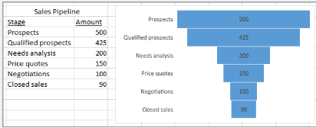

Slide 43
5.3 Adding maps on dashboard
You can use a map chart to compare values and show categories across geographical regions. Use it when you have geographical regions in your data, like countries/regions, states, counties or postal codes.

Slide 44
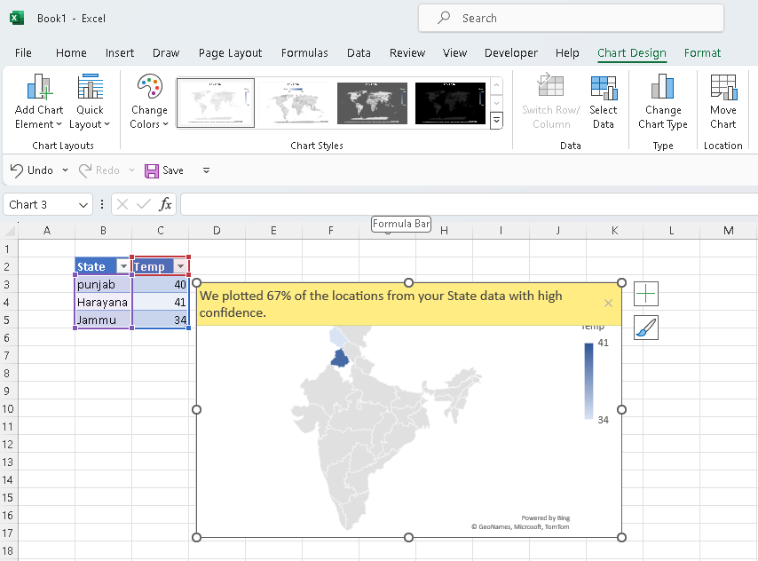

Slide 45
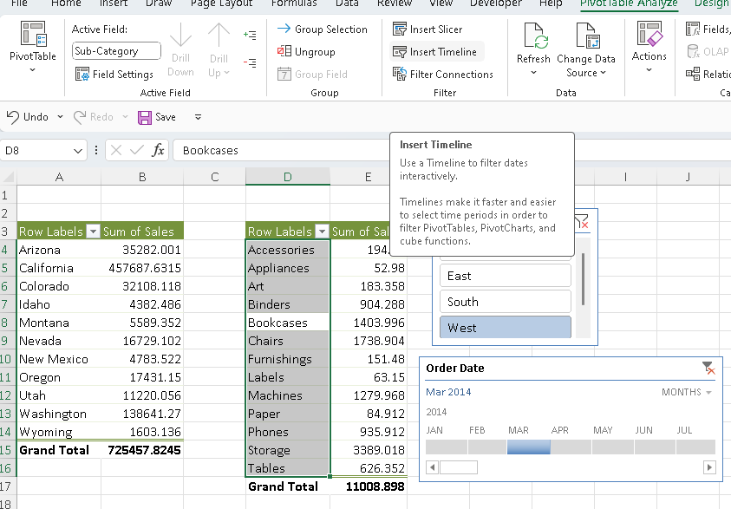
5.4 Adding slicers and timelines

Slide 46
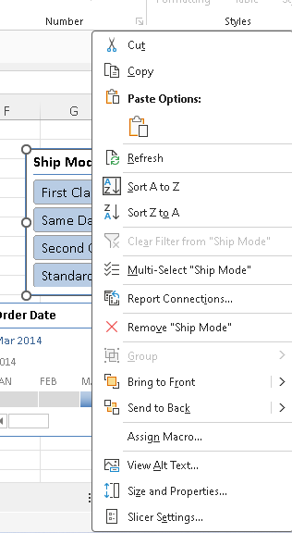
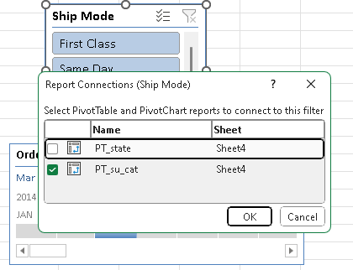
6. Connecting slicers with multiple pivot tables

Slide 47
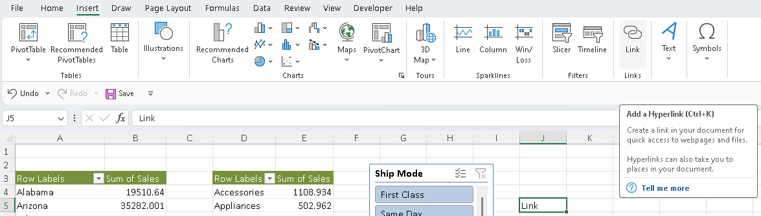
7. Adding hyperlinks to navigate between different sheets

